Slide 1
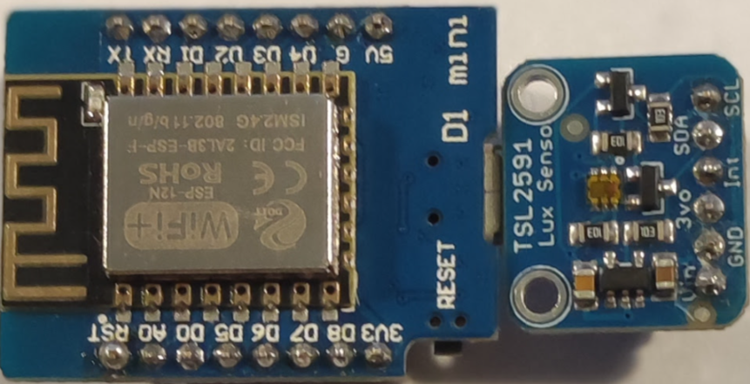
Fotómetro
Rev 1.0 - 2025
GEDA – Ing. Jacoby

Slide 2
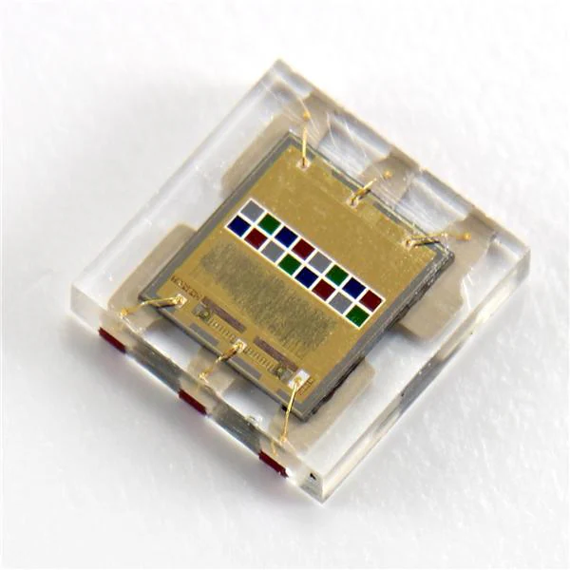
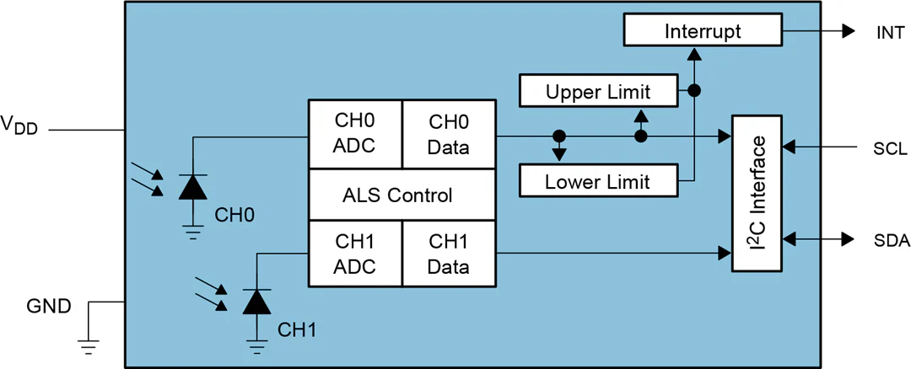

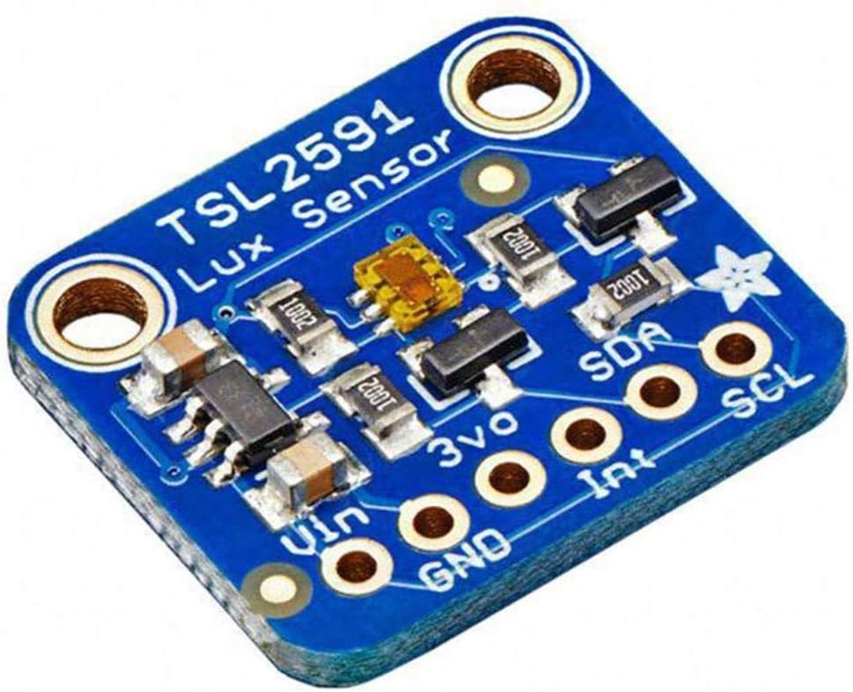

Fotómetro
Basado en el IC TSL2591
GEDA – Ing. Jacoby

Slide 3
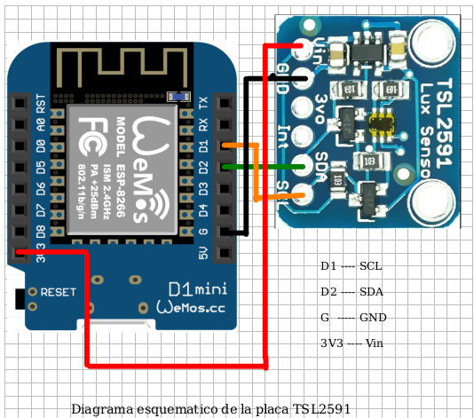
Hardware Setup
1- Wire the following circuit.
2- Flash tsl2591.ino on D1 mini.
Board: LOLIN(WEMOS)D1 R2 & mini
CPU :ESP8266
Micro USB
GEDA – Ing. Jacoby

Slide 4
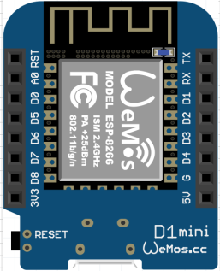

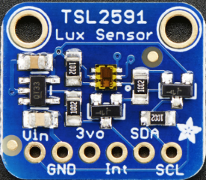
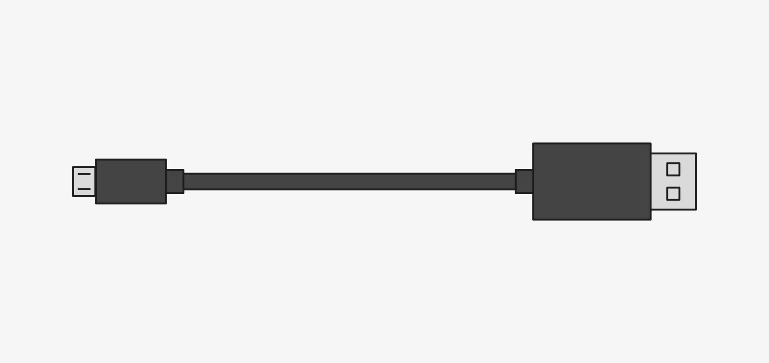
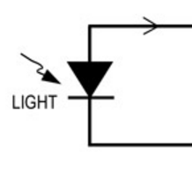


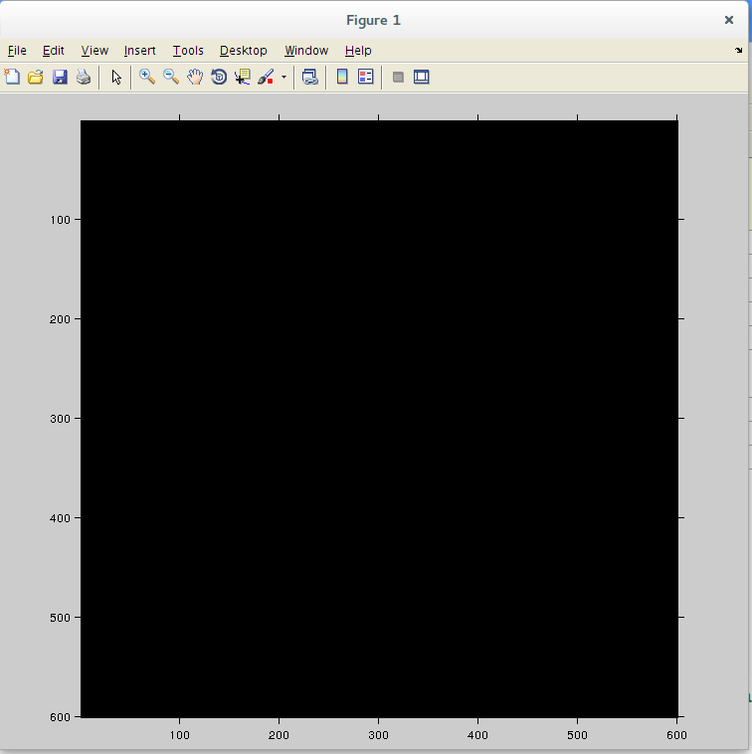
Hardware Setup
Fotómetro
USB
Fotómetro
Matlab genera 11 niveles de gris en la pantalla.
Por cada nivel generado el fotómetro envía la lectura a Matlab. Una vez almacenadas las 11 lecturas se calcula el valor de gamma.
GEDA – Ing. Jacoby

Slide 5
Tests
Automated Gamma Measurement for LCD display using Matlab:
Measurement Loop
Generate 11 Gray Levels
USB Serie
GEDA – Ing. Jacoby

Slide 6
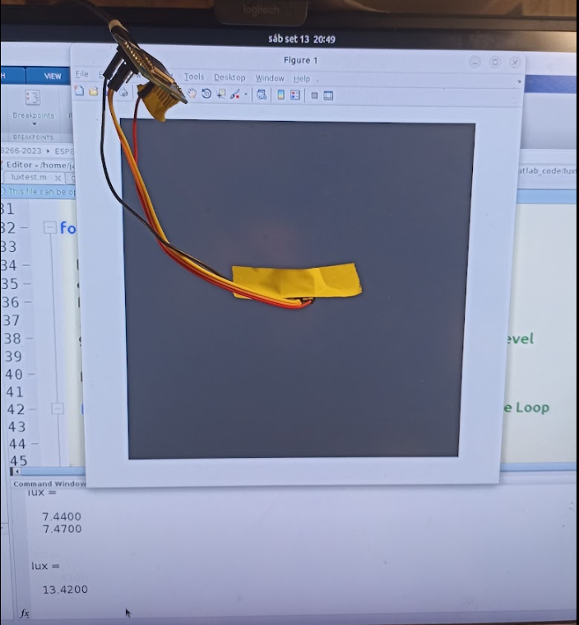
Montaje
Fotómetro
GEDA – Ing. Jacoby

Slide 7
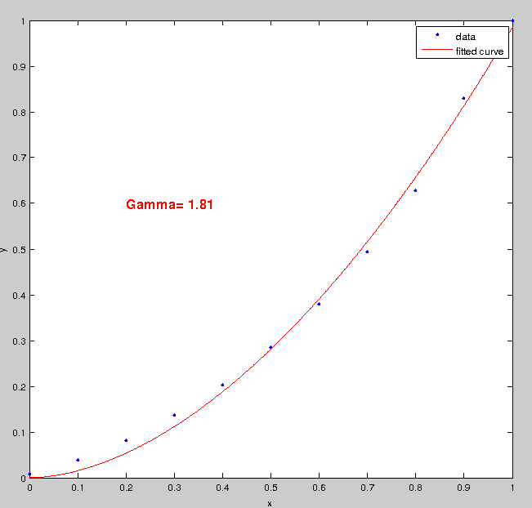
Tests: Samsung T24C550
Automated Gamma Measurement for LCD display using Matlab
Results:
GEDA – Ing. Jacoby

Slide 8
Tests: Samsung T24C550
Automated Gamma Measurement for LCD display using Matlab
Results:
Gamma Control | Measured Gamma
-3 | 1.6
0 | 1.8
+3 | 2.1
GEDA – Ing. Jacoby

Slide 9
Matlab Files
Luxtest.m : Photometer Measurement Program
Luxmeter.m : Returns Light Luminosity in lux
Generarte_gray.m : Sets Gray level on screen.
Start
Luxtest.m
Set Gray Level
Measure
(Luxmeter.m)
Last ?
Adjust acquired data
Using
CFT (Curve fitting Tool)
and find out gamma
Plot Results,
Fitted Curve and Gamma
Next Gray Level
END
GEDA – Ing. Jacoby

Slide 10
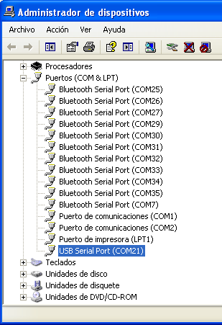
Measurement setup and use
1- Connect the photometer to USB to computer USB port
2- Find out the USB serial port on computer (COMxx)
3- Edit and modify serial port on luxmeter.m
ser = serial('COM1'); % Windows port style
ser = serial('/dev/ttyUSB0'); % Linux port style
4- Attach photometer as close a possible to monitor
5- Open matlab and run luxtest.m
GEDA – Ing. Jacoby

Slide 11
Measurement setup and use
Notes: Each sample is taken every 2 seconds (defined on firmware)
Two samples are taken per gray level and averaged
(see Nmeas on luxtest.m)
GEDA – Ing. Jacoby

